Slide 1
West Kent Federation of Women’s Institutes
Safeguarding – Everybody’s Responsibility

Slide 2
Safeguarding and the WI – some key words from the NFWI Safeguarding Policy

Slide 3
What is adult safeguarding?

Slide 4
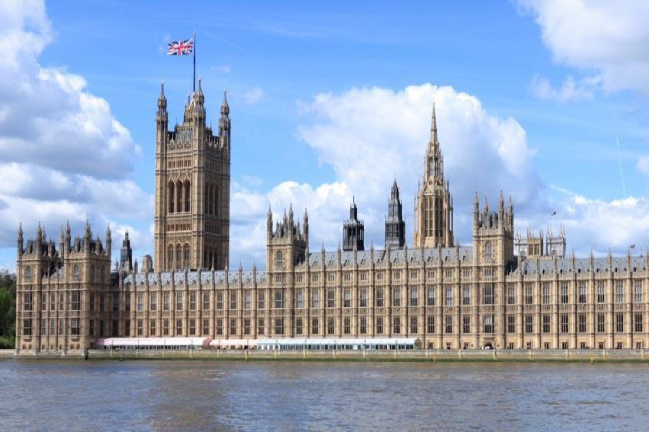
The main Legislation is….
The Care Act 2014

Slide 5
Other legislation involved….
Mental Capacity Act 2005
Others such as Counter Terrorism 2015, Vulnerable Groups 2006
Also expectations of organisations like the Charities Commission
Domestic Abuse Act 2021

Slide 6
What does the Care Act mean by abuse?
abuse
physical
organisational
emotional
neglect
sexual
financial
modern slavery
domestic
self neglect
discriminatory

Slide 7
There are also types of harm which are relevant to adult safeguarding
Harm
Cyber Bullying
Forced Marriage
Radicalisation
Mate Crime

Slide 8
Who is covered by Adult Safeguarding?
Safeguarding duties apply to an adult (this is someone 18 and over) who meets all the below:
Has needs for care and support (whether a local authority is providing them or not) and
Is experiencing or is at risk of abuse or neglect and
As a result of these care and support needs is unable to protect themselves from the risk or experience of abuse or neglect

Slide 9
Who might be considered an adult at risk?
an older person
a person with a physical disability, a learning difficulty or a sensory impairment
someone with mental health needs, including dementia or a personality disorder
a person with a long-term health condition
someone who misuses substances or alcohol to the extent that it affects their ability to manage day-to-day living
But being one of the above does NOT mean an automatic ‘adult at risk’ status.

Slide 10
If you notice…..
change in behaviour
change in appearance
change in mood
signs of injury
emotional distress
or anything else that makes you wonder if something is wrong you
need to….. ASK…..
….but don’t forget that people have a right NOT to disclose and you can’t force information from them

Slide 11
But if they do want to talk about abuse….
Do not press them for more details
Do not stop them when they are freely recalling significant events
Do not dismiss what they have told you or try to relate your own experiences
Do not promise to keep secrets; but do explain that the information will only be passed to those who "need to know", and try to be specific about who these might be
Do not tell anybody who doesn't need to know – remember the rules of confidentiality
Do not be judgmental e.g. "why didn't you run away”?
Do not make promises that you cannot keep
Do not contact the alleged abuser or anyone who might be in touch with him / her
Do not ask leading questions or try to investigate the events

Slide 12
Why do people not report…
Failure to recognise what they have seen is abuse
Fear their suspicion will not be believed
Fear of reprisals if they do report
Fear of ‘heavy handed’ responses affecting the ‘victim’
Don’t want to breach confidentiality
Not sure if concerns are valid
Not sure how to report

Slide 13
When suspected abuse MUST be reported to the relevant authority
Children at risk in their home or being cared for by an adult at risk or the alleged perpetrator of harm
Organisational abuse
Abuse perpetrated by an employee
Abuse happened on property owned or operated by an organisation providing care
Prevent or report a Crime/satisfy a Court Order
Immediate threat to life or serious harm
Suspicion of duress or coercion of the adult at risk

Slide 14
You’ve decided to report an abuse…
If a WI member was abused
If someone outside the WI was abused
Gather the information you have been given
Complete the NFWI Reporting Form (available on NFWI and WKFWI websites)
Email it to the WKFWI FSO safeguardingofficer@wkfwi.org.uk
Advise them that there are organisations who can help them (many are listed in the WKFWI Safeguarding FAQs document)
Help them to make contact if you feel able - but don’t get drawn into something you don’t want to
If it is a child being abused or the child of an adult being abused you MUST report to the relevant Local Authority

Slide 15
Possible safeguarding scenario 1….
Scenario
The speaker at your WI meeting was the local Crime Prevention Officer and they spoke about many things including strategies to keep safe in public.
During the talk, one of the members said as an aside ‘I’m scared of my husband - so it’s keeping safe in my home I need strategies on’.
There are no under 18’s or adults at risk in the household.
Approach
Without prying, see if she will open up to you in a safe environment.
Offer contact details of relevant organisations.
Even if she contacts one of these organisations your safeguarding concern should be reported on the NFWI Reporting Form and emailed to the WKFWI FSO.

Slide 16
Possible safeguarding scenario 2….
Scenario
The speaker at your WI meeting was the local Crime Prevention Officer and they spoke about many things including strategies to keep safe in public.
During the talk, one of the members said as an aside ‘I’m scared of my husband – so it’s keeping safe in my home I need strategies on’.
There are children or adults at risk living at this household.
Approach
Without prying, see if she will open up to you in a safe environment.
Offer contact details of relevant organisations.
As there are children or adults at risk in the household either you or she must complete a NFWI Reporting Form and email it to the WKFWI FSO .
Social Services should also be made aware.
If there is immediate danger, the Police should also be contacted.

Slide 17
Possible safeguarding scenario 3….
Scenario
Your 35-year-old brother has an autism diagnosis and doesn’t always read social situations very well. He has recently been befriended by some people you are suspicious of, and they spend a lot of time at his home. You have noticed that ‘family treasures’ cannot be found, and he is now always short of money.
Approach
This looks like he could be being taken advantage of and due to his condition does not have the capacity to recognise this or take action.
Even if no physical harm has occurred so far this should be reported to the Police or Social Services.
The WKFWI FSO does not need a report of this event.

Slide 18
In Summary
Safeguarding is everybody’s responsibility.
Even if abuse is not occurring, it may be a situation that someone needs support with.
Don’t worry that you have misunderstood a situation.
There are certain circumstances where abuse MUST be reported even if the person being abused doesn’t want it to be.

Slide 19
What has the WI done about meeting it’s safeguarding obligations
NFWI
Appointed Ann Craft Trust to deliver safeguarding training to NSO and FSOs
Created a Safeguarding Policy, NSO/FSO Role Descriptions, Safeguarding Leaflet and Reporting Form
Appointed an NSO and encouraged federations to appoint FSOs
West Kent Federation
Discussing safeguarding at Board level within a specific agenda spot
Appointed FSO
Created/creating FAQs, WKFWI Procedure, quiz and presentation

Slide 20
Acknowledgements etc
Training of FSO and other background information
Ann Craft Trust
Ideas for slide content
Cambridgeshire & Peterborough Safeguarding Adults Board
Hampshire County Council
Kent & Medway Safeguarding Adults Board
Leicester Safeguarding Adults Board
Leicestershire and Rutland Safeguarding Adults Board
Authorship and Version Number
WKFWI (FSO) - V04a 2024

